Slide 1
Shoring up System Protection: Building an Interdisciplinary Client System with Nursing and Nutrition Students
Joan Timalonis, MSN, RN, CNE,
Sharon M. Melincavage, DEd, RN, CRNP-BC, CNE

Slide 2
Abstract
Faculty in the Nursing and Nutrition Departments at Cedar Crest College recognize that an ever changing health care environment produces constant stressors to the Client System of Health Care Providers. Nursing and nutrition faculty designed a created environment using simulation to foster the development of support for the health care team as a client system. The intent of this simulation is to create an exchange between and among nursing and nutrition students that enhances their perception of working together as a means to shore up each other’s lines of defense, thus building healthy functioning interdisciplinary teams. The simulated environment emphasizes the psychological variable to promote support systems for team members, and the social cultural variable, to promote education about each other’s role responsibilities. Knowledge gained from this experience, and interdisciplinary relationships that are formed with each other become preventative interventions to build system protection for health care teams.

Slide 3
Objectives
At the end of this presentation the Learner will be able to:
1. Describe the benefits of using the Neuman Systems
Model as a framework to build interdisciplinary
relationships.
2. Create an interdisciplinary simulation to support health care
providers as Client Systems.

Slide 4
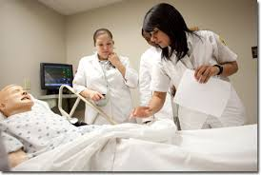

Slide 5
Background for Project
The Why of Interprofessional Education (IPE)?
Necessity
To prepare a “collaborative practice ready” healthcare
workforce
(Suiter, Davidson, McCaw, Fenelon, 2015)
Interprofessional collaboration can improve healthcare
outcomes (Reeves, Perrier, Goldman, Freeth, Zwarenstein, 2013).
Obligation
Required by accrediting organizations for healthcare
education
The How of IPE?
Begins with motivation – the stimulus to start the process.

Slide 6
Interprofessional Education and Collaboration
World Health Organization (WHO)
“Interprofessional education (IPE) occurs when students
from two or more professions learn about, from, and with each other
to enable effective collaboration and improve health outcomes.”
(WHO 2010)
Interprofessional Education Collaborative (IPEC)
Formed in 2009 by six national education associations of
schools of the health professions
To promote efforts to advance interprofessional learning
experiences to prepare future health professionals for team-
based care to improve population health outcomes (IPEC, 2017).
https://www.ipecollaborative.org/about-ipec.html
IPEC competencies for interprofessional education and practice were utilized for this project (IPEC 2016)

Slide 7
Research on Interprofessional Education
Interprofessional learning enhances healthcare students’ professional identity, skills, knowledge, & attitudes towards teamwork, and increases awareness of whole person care (Hood, Cant, Baulch, Gilbee, Leech, Anderson, Davies, 2014; MacDonnell, George, Nimmagadda, Brown, Gremel, 2016; Suiter, Davidson, McCaw, Fenelon, 2015)
Nursing and dietetic students participating together in client simulation demonstrated improved interprofessional communication (Gibbs, George, Barkley, Meyer, 2015)

Slide 8
Research on Interprofessional Education
“Experiences with other student members of the health care team afforded students opportunities to:
Apply knowledge in solving real world clinical problems,
Develop knowledge of professional roles other than their
own, and
Develop collaborative skills as a member of an
interprofessional team.” (Buhse & Ratta, 2017)

Slide 9
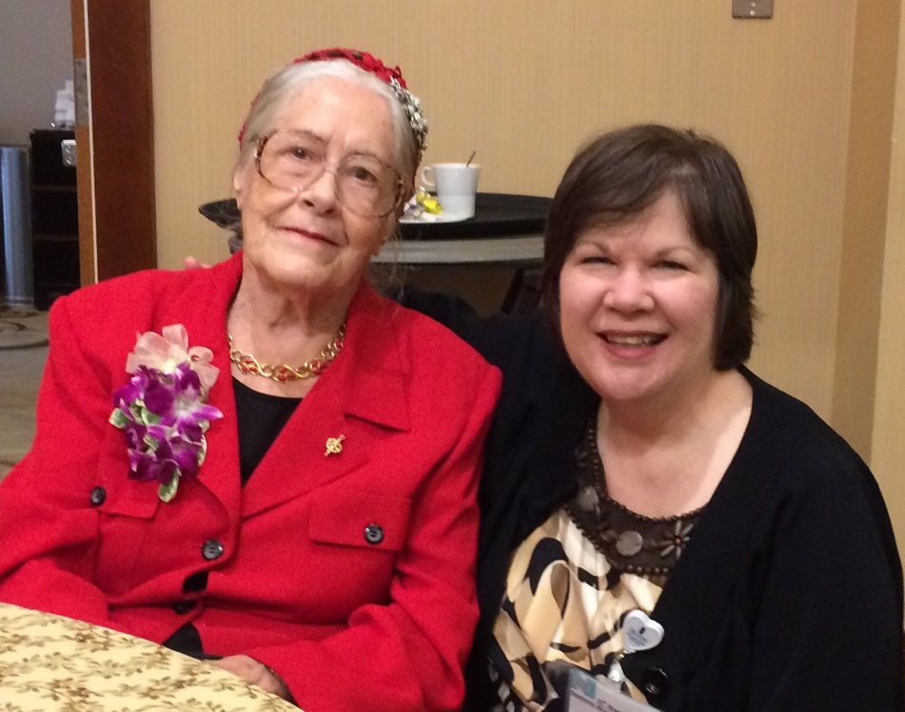
Theoretical Framework: Neuman System’s Model (NSM)
NSM is a framework for clinical experiences at Cedar Crest College
“The NSM fosters client care partnerships & a spirit of community with other health care givers.” (Neuman & Reed, 2007)
An interprofessional project using the lens of the Neuman Systems Model was developed for nursing & nutrition students

Slide 10
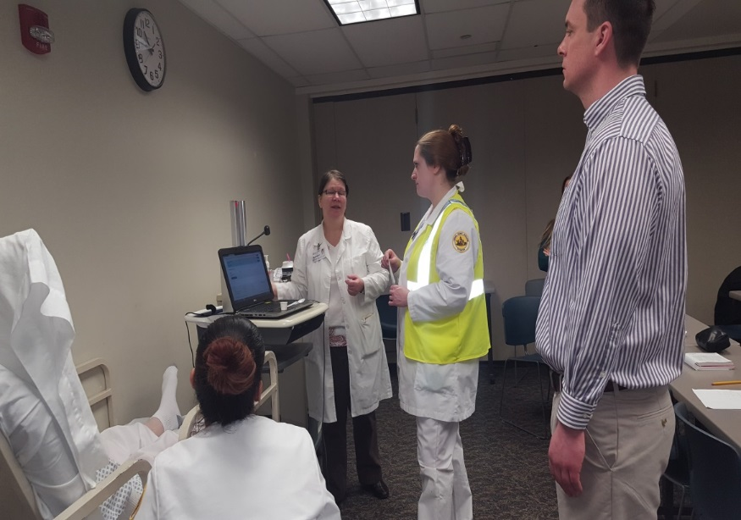
Interprofessional Education: Implementing an Unfolding Simulation
Started with an existing simulation for nursing students
Approached nutrition faculty and assessed logistics of activity
Planned outcomes and interventions for the activity
Students gathered for bedside report around the student in the client role
Nursing & nutrition students collected subjective and objective data from the client
Nursing student administered selected medication to simulated client
Nursing & nutrition students planned & implemented care to client and significant other
Goal: “Shore up FLD” to mold what the client will become: A stronger, unified client system/team.

Slide 11
Assessment of Client’s Flexible Line of Defense
Social Cultural Variable
Nutrition students invited to nursing building to
work with a group of nursing students
Nutrition students had no previous hospital
clinical experience (Outpatient focus)
Terminology of each profession is different
Providing team based care to a client for the first time
Nursing students in uniform, nutrition students dressed in business casual

Slide 12
Assessment of Client’s Flexible Line of Defense
Psychological Variable
First exposure to bedside report & medication
administration for all students
First time working with students in another discipline
Other stressful activities for nursing students scheduled on same day
Exposure to new faculty members
Performance anxiety with others watching
Nursing students outnumbered nutrition students

Slide 13
Assessment of Client’s Flexible Line of Defense
Physiological Variable
Very busy day with multiple scheduled activities
Not much sleep due to clinical prep
Changes in eating habits due to scheduled activities

Slide 14
Assessment of Client’s Flexible Line of Defense
Developmental Variable
Students of various age groups: Traditional &
Adult Learners
Both in beginning clinical experiences
Nursing students junior level
Nutrition students senior level
Previous health care experiences

Slide 15
Assessment of Client’s Flexible Line of Defense
Spiritual Variable
Beliefs to guide students’ own health care practices that may conflict with simulated care scenarios
Beliefs that help promote self efficacy to perform in simulation

Slide 16
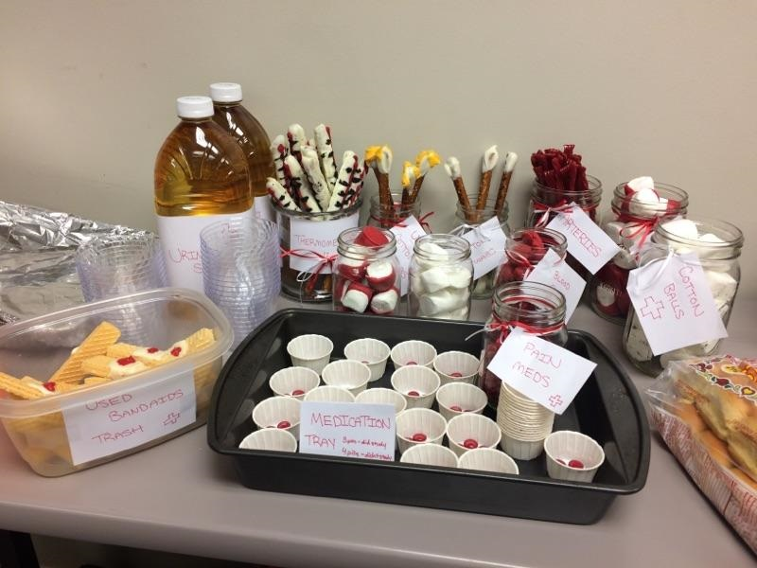
Primary Prevention: Retain Wellness of Client Team
Contemplated stressors students might encounter during the activity
Planned for food & restroom breaks
Considered resources to perform assessments & provide teaching
Books
Client information
Equipment
Planned to discuss the role of the Registered Nurse (RN) and the Registered Dietician (RD) in the clinical setting
Ensured at least 1 faculty member present from each discipline

Slide 17
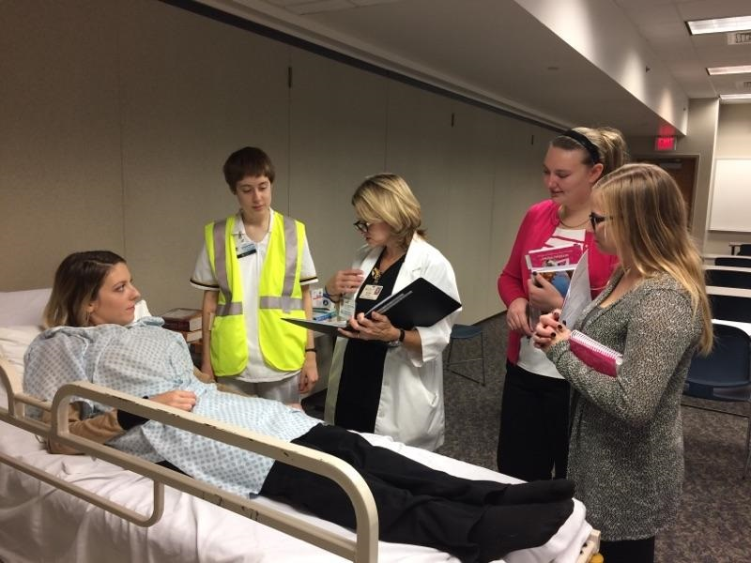
Secondary Prevention: Attain Wellness of Client Team
Introduced students to each other & to client(s) in scenario
Set ground rules to encourage mutual respect for each other & use active listening and respectful language
Organized in circle or semi-circle for communication & collaboration
Promoted and role-modeled trusting relationships
Asked to define terms of each discipline (Ex. DNI)

Slide 18
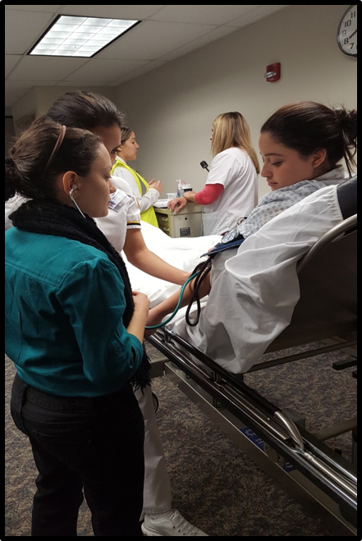
Secondary Prevention Cont.
Encouraged to ask questions of each other
Provided feedback to students to clarify information
Introduced bar code scanning system & electronic medical record (EMR)
Encouraged to share information pertinent to best practices in discipline
Engaged students in client-centered problem solving

Slide 19
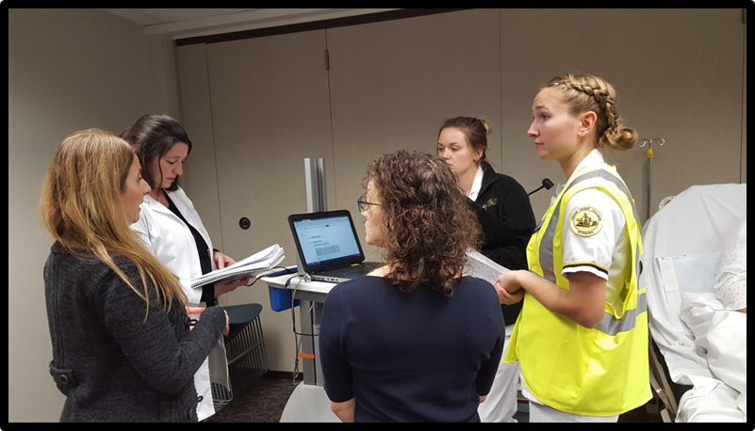
Tertiary Prevention: Maintain Wellness of Client Team
Debriefed simulation with students
Reflected on team performance
Communicated importance of team work
Summarized key concepts and value each discipline brings to client care
Administered post activity survey for further reflection, evaluation & further reconstitution

Slide 20
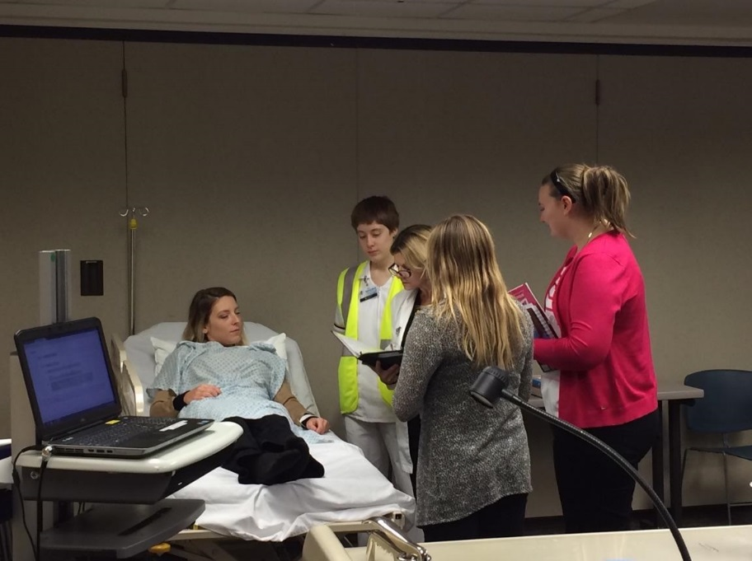
Six themes identified from Students’ Perceptions about Working Together
Role Distinctiveness
Client Centeredness
Knowledge Acquisition
Role Connectivity
Shared Value & Respect
Collaboration for Quality
Client Outcomes

Slide 21
Role Distinctiveness
“I learned that both professions bring different perspectives to the table. I learned more about specific diets when on meds and more about dysphagia.”
“…I forget that there are nutritionists working alongside nurses in medical settings.”

Slide 22
Client Centeredness
“If the nutrition & nursing student work together, they can promote good healthy clients. For example, nurse notes patient is not drinking, lips are dried & is urinating small amounts of dark urine, the nutritionist can promote liquids & foods that will accommodate client & promote hydration.”
“It is important to ask questions & learn from each other for best care of the client.”

Slide 23
Knowledge Acquisition
“I learned basic nutrition assessments dietitians use to measure or determine hydration status, ability to tolerate feeding & malnutrition.”
“I learned the importance of a healthy diet. It shortens the length of hospital stay & promotes healing.”
Notes:
“…nursing students feel…comfortable discussing nutritional concerns with dieticians..feel less like it’s all on them to decide if they’re at risk for malnutrition.”
“…the relationship between nutrition and nursing is very important…They must work together to make sure the client is receiving care and to avoid mistakes.”

Slide 24
Role Connectivity
“Healing really coincides with so much from medication to nutrition, to physical therapy & so on.”
“Nutrition & nursing measures used together can be very helpful and one cannot work without the other!”

Slide 25
Shared Value & Respect
“Before this, I didn’t realize how much the nutritionist is involved in client outcomes.
“The nutrition aspect of it is just as important as the nursing aspect.”
“They are closely intertwined & share common values.”

Slide 26
Collaboration for Quality Client Outcomes
“A client is more than just their diagnosis. They are a whole person…they have a variety of needs…that requires many specialties.”
“You need to have good communication to collaborate on how to best treat a client. I thought…doctors did their jobs, nursing does their job, & nutritionists do their job…However this experience taught me that we need to collaborate…to provide the best treatment for the client.”

Slide 27
Lessons Learned
Scheduling
Resources
Departmental support
Buy-in from faculty
Education for faculty

Slide 28
Conclusions
IPE provides support for students of both disciplines
Neuman Systems Model can be used as a framework for Interprofessional Education
Decreased stressors
Shored up the Flexible Lines of Defense
Hopefully will strengthen their Normal Lines of Defense
Students can learn with, from & about one another during an interprofessional simulated learning activity
Working together as a team will promote positive client outcomes and ultimately shore up client’s lines of defense

Slide 29
References
Buhse, M. & Ratta, C. D. (2017). Enhancing interprofessional education with team-based learning. Nurse Educator, 00 (0), 1-5.
Gibbs, H., George, K., Barkley, R, & Meyer, M. (2015). Using multiple patient simulations to facilitate interprofessional communication between dietetic and nursing students and improve healthcare processes. Topics in Clinical Nutrition, 30(3), 230-238.
Hood, K., Cant, R., Baulch, J., Gilbee, A., Leech, M., Anerson, A, & Davies, K. (2014). Prior experience of interprofessional learning enhances undergraduate nursing and healthcare students’ professional identity and attitudes to teamwork. Nurse Education in Practice, 14, 117-122.
Interprofessional Education Collaborative (2016). Core competencies for interprofessional collaborative practice: 2016 update. Washington, D.C: Interprofessional Education Collaborative.
Interprofessional Education Collaborative (2017). What is interprofessional education (IPE)? Retrieved from https://www.ipecollaborative.org/about-ipec.html

Slide 30
References
MacDonnell, C., George, P., Nimmagadda, J., Brown, S., & Gremel, K. (2016). A team-based practicum bringing together students across educational institutions and health profession. Instructional Design and Assessment, 80(3), 1-7.
Neuman, B. & Reed, K. S. (2007). A Neuman Systems Model perspective on nursing in 2050. Nursing Science Quarterly, 20(2), 111-113.
Reeves, S, Perrier, L., Goldman, J. Freeth, D., & Zwarenstein, M. (2013). Interprofessional education: Effects on professional practice and healthcare outcomes (update). Cochrane Database of Systematic Reviews, 2013 (3), 1-47.
Suiter, S. V., Davidson, H. A., McCaw, M., & Fenelon, K-F. (2015). Interprofessional education in community health contexts: Prepearing a collaborative practice-ready workforce. Pedagogy in Health Promotion, 1(1), 37-46.
World Health Organization (2010). Framework for action on interprofessional education & collaborative practice. World Health Organization, Geneva, Switzerland: WHO Press.

Slide 31
Questions?

Slide 32
Contact Information
Joan Timalonis, MSN, RN, CNE
Assistant Professor of Nursing
jttimalo@cedarcrest.edu
Sharon M. Melincavage, DEd, RN, CRNP-BC, CNE
Associate Professor of Nursing
Director of the Graduate Nursing Program
smmelinc@cedarcrest.edu
Cedar Crest College
100 College Drive, Allentown, PA 18104

